Slide 1

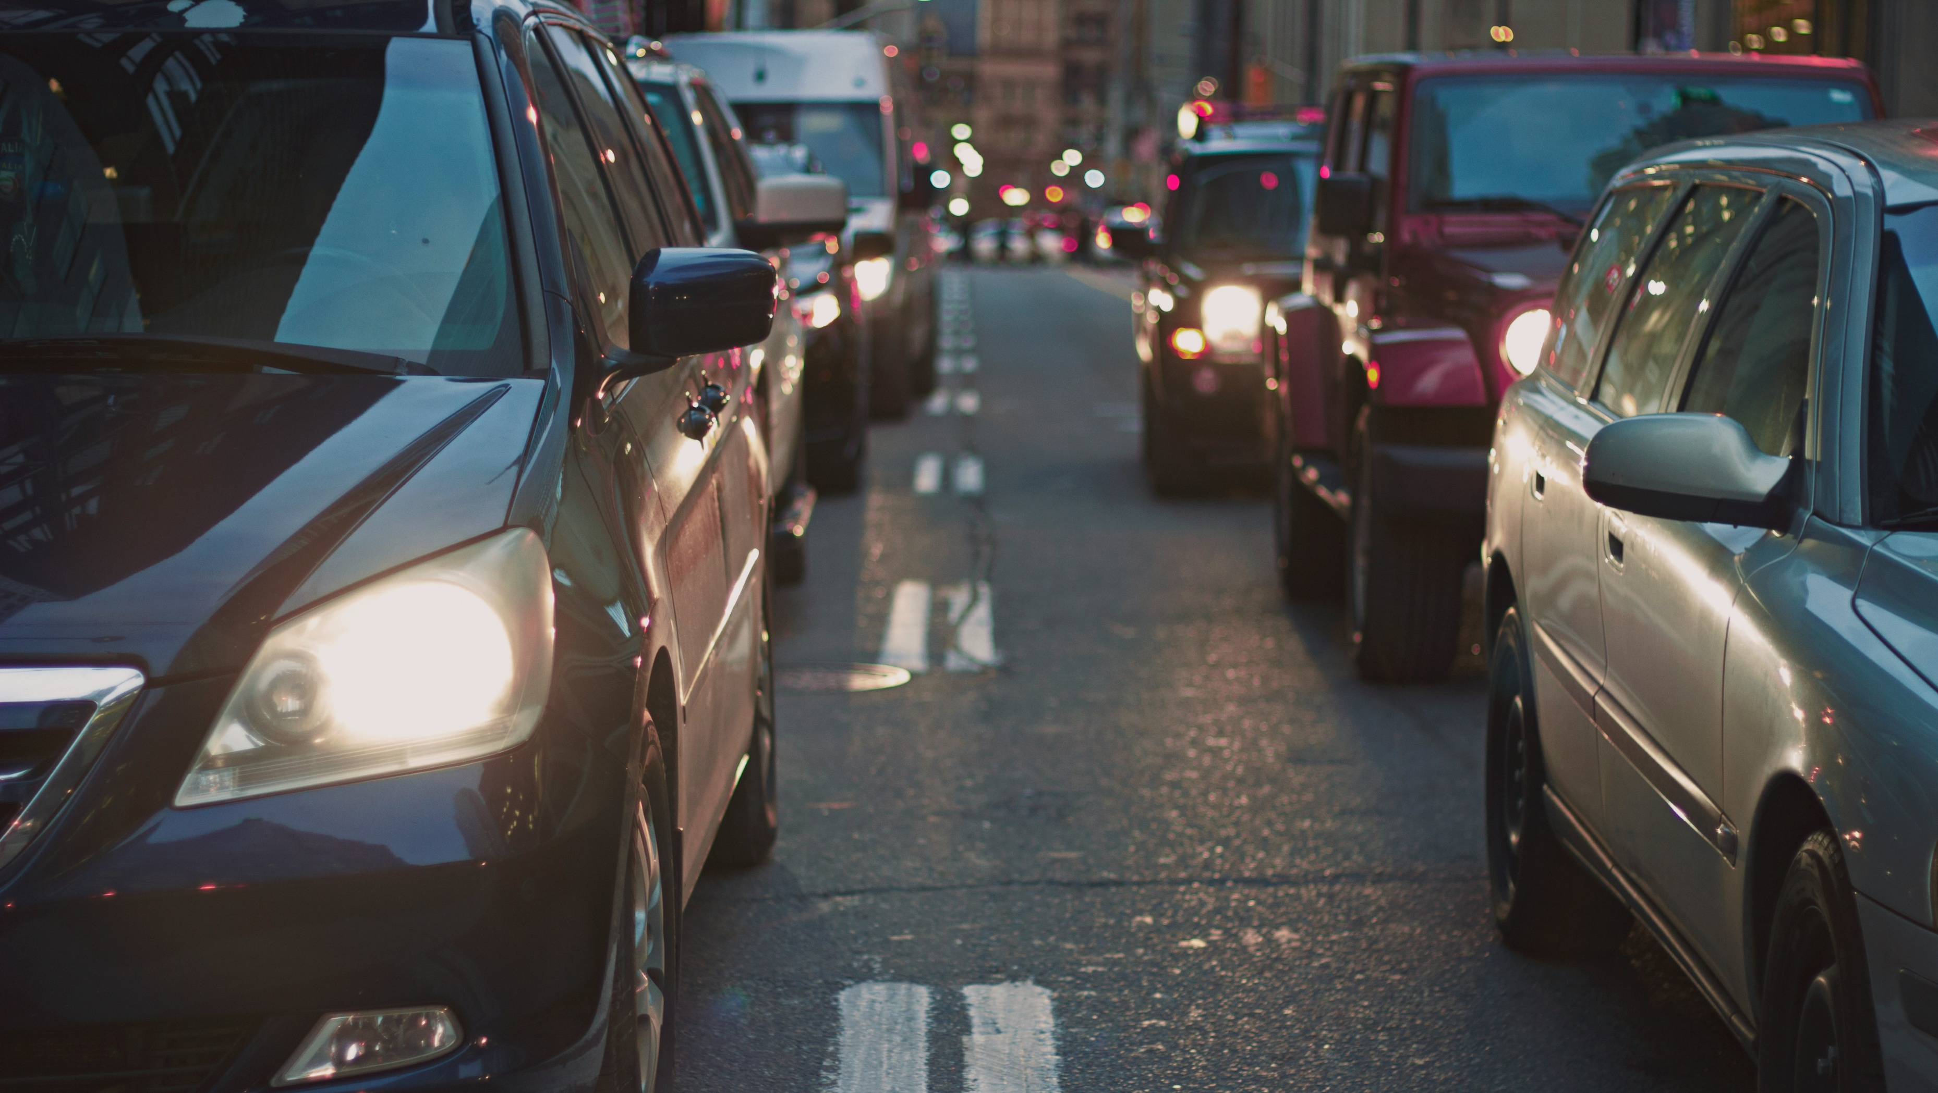

Nashville Accidents Jan 2018 - Apl 2025

Slide 2
Outline:
Overview
Accident Trends Over Time
Time of Day Analysis
Weather Conditions
Time of Day vs Weather Conditions
Recommendations

Slide 3
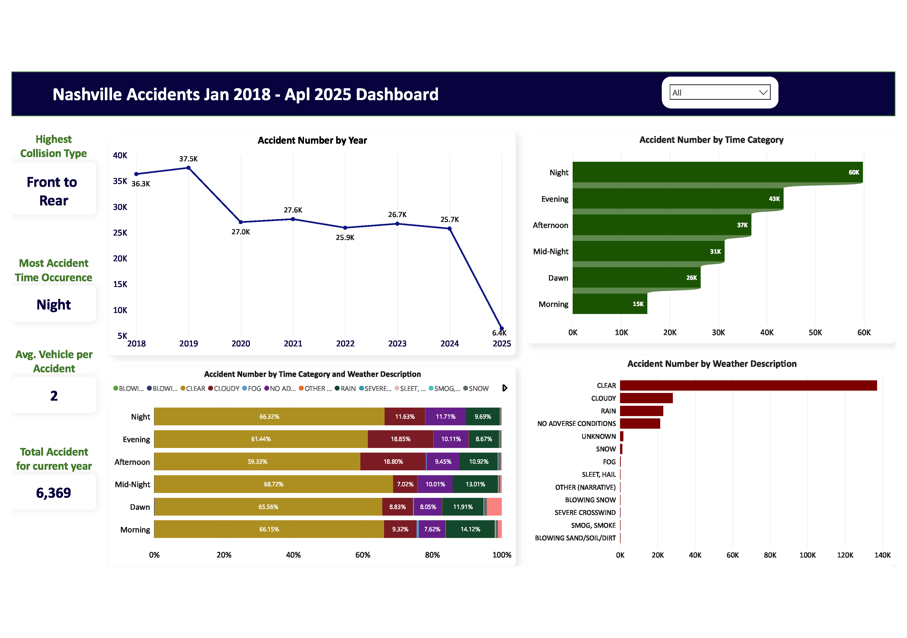
Accident Trends Over Time
Accident volumes declined steadily from 2018 and stabilized around 2020
Post-2020, the number of accidents has remained relatively consistent

Slide 4
Time of Day Analysis
Evening and Night periods recorded the highest number of accidents..
Clear weather was the most common condition during these incidents.

Slide 5
Time of Day vs. Weather Conditions
A stacked bar chart illustrates accident counts by weather conditions across Morning, Afternoon, Evening, and Night.
Clear weather consistently showed the highest accident counts across all time periods.

Slide 6
Recommendations
Implement or increase use of rear-end collision warning systems, public awareness campaigns, and driver education on safe following distances.
Promote campaigns targeting drowsy driving and impaired driving awareness, especially at night.
Use insights on accident timing to improve lighting infrastructure, traffic signal coordination, and road signage visibility during high-risk hours (evening/night).

